Slide 1
Vectors
Linear Regression – The Gradient Descent Perspective

Slide 2
Outline
The Cost Function in Linear Regression
Gradient Descent for Linear Regression

Slide 3

The Cost Function
RECALL: In Linear Regression, the cost (loss, or error) function is
$$L=\sum_{i=1}^{n}{ε_{i}^{2}}$$
$$= \sum_{i=1}^{n}{{\left(y_{i}−{\hat{y}}_{i}\right)}^{2}}$$
$$=\sum_{i=1}^{n}{{\left(y_{i}−β_{0}−\sum_{j=1}^{n}{β_{j}x_{ij}}\right)}^{2}}$$
Thus,
$\frac{∂L}{β_{0}}=\frac{2}{n}\sum_{i=1}^{n}{{−\left(y_{i}−{(β}_{1}x_{i}+β_{0}\right))}^{}}$and $\frac{∂L}{β_{1}}=\frac{2}{n}\sum_{i=1}^{n}{{−x_{i}\left(y_{i}−{(β}_{1}x_{i}+β_{0}\right))}^{}}$

Slide 4
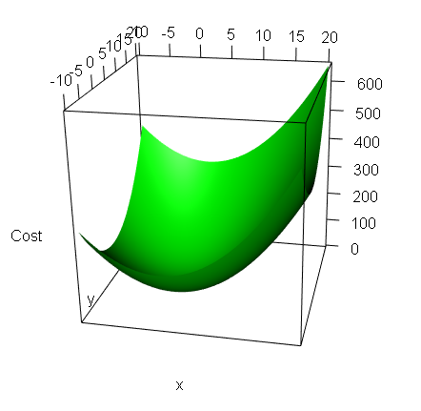
Gradient Descent in Linear Regression
Note that the loss function is quadratic, and thus has a minimum point.
Min Cost / Error

Slide 5
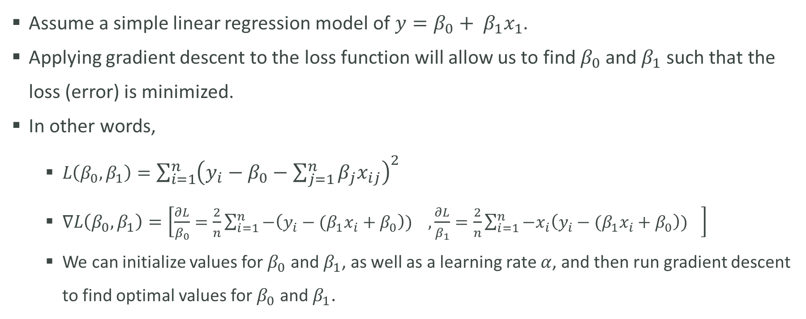
Gradient Descent in Linear Regression
Assume a simple linear regression model of $y=β_{0}+ β_{1}x_{1}$.
Applying gradient descent to the loss function will allow us to find $β_{0}$ and $β_{1}$ such that the loss (error) is minimized.
In other words,
$L\left(β_{0},β_{1}\right)=\sum_{i=1}^{n}{{\left(y_{i}−β_{0}−\sum_{j=1}^{n}{β_{j}x_{ij}}\right)}^{2}}$
$∇L\left(β_{0},β_{1}\right)=\left[\frac{∂L}{β_{0}}=\frac{2}{n}\sum_{i=1}^{n}{{−\left(y_{i}−{(β}_{1}x_{i}+β_{0}\right))}^{}},\frac{∂L}{β_{1}}=\frac{2}{n}\sum_{i=1}^{n}{{−x_{i}\left(y_{i}−{(β}_{1}x_{i}+β_{0}\right))}^{}}\right]$
We can initialize values for $β_{0}$ and $β_{1}$, as well as a learning rate $α$, and then run gradient descent to find optimal values for $β_{0}$ and $β_{1}$.

